Slide 1
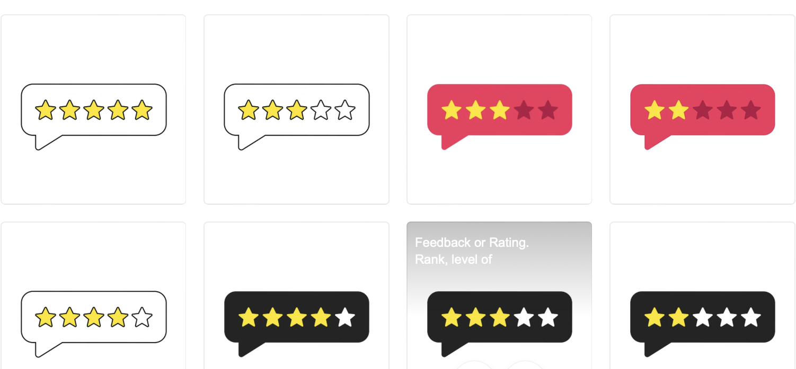











SENTIMENT ANALYSIS USING PYTHON
(updated)
THAO TRAN (★★★★★)
_______________________________________________________
_______________________________________________________
______________________________________________________
THU TRAN (★★★)
_______________________________________________________
_______________________________________________________
______________________________________________________
HUITING WU (★★★★)
_______________________________________________________
_______________________________________________________
______________________________________________________
DATA PROCESSING
WORDCLOUD
TF-IDF SCORE
MACHINE LEARNING MODEL
SUMMARY

Slide 2
Sentiment Analysis using Python
(updated)
DATA PROCESSING
WORDCLOUD
THAO TRAN (★★★★★)
_______________________________________________________
_______________________________________________________
______________________________________________________
TF-IDF SCORE
THU TRAN (★★★)
_______________________________________________________
_______________________________________________________
______________________________________________________
MACHINE LEARNING MODEL
HUITING WU (★★★★)
_______________________________________________________
_______________________________________________________
______________________________________________________
SUMMARY

Slide 3
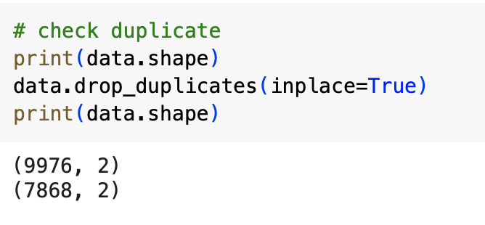
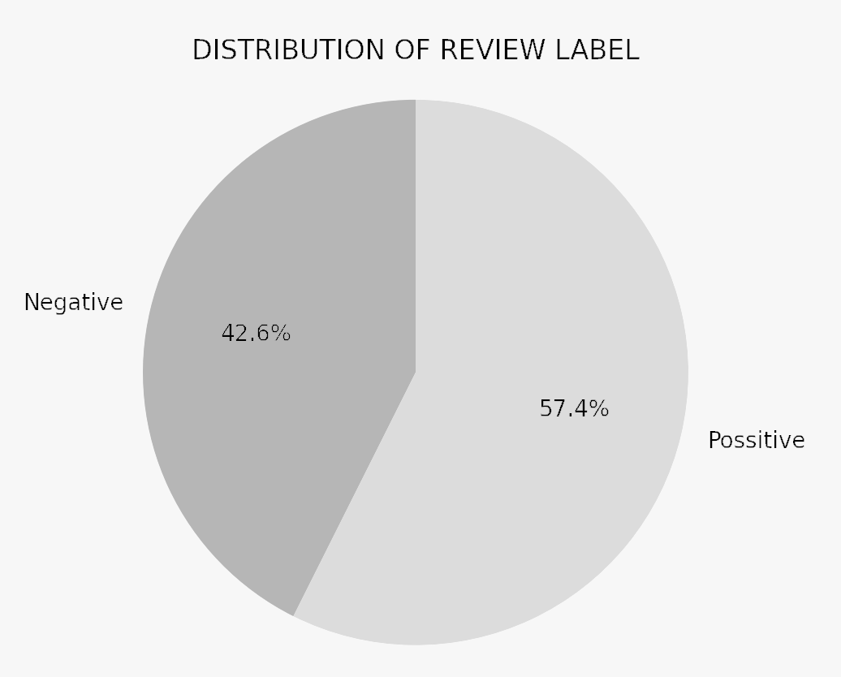
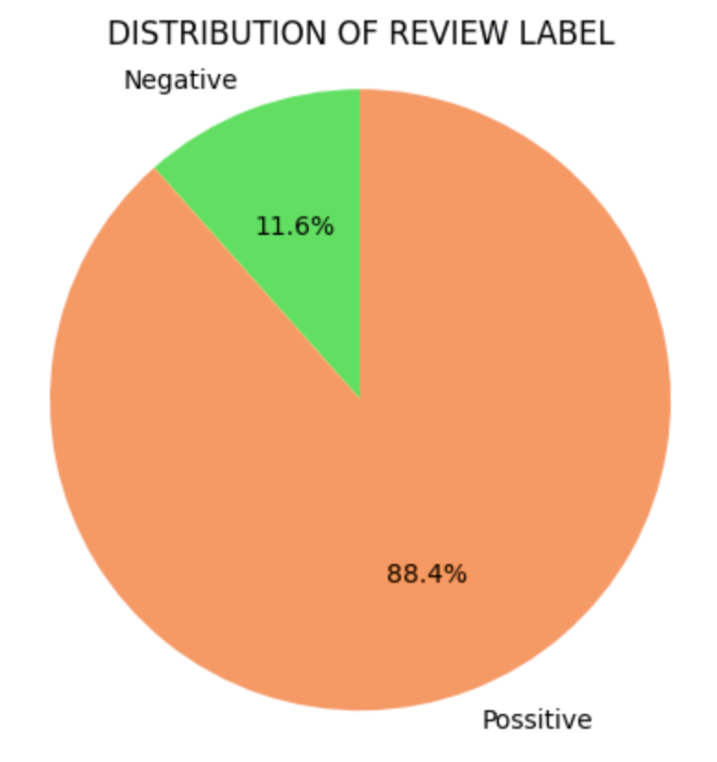
Sentiment Analysis using Python
(updated)
MACHINE LEARNING MODEL
TF-IDF SCORE
WORDCLOUD
DATA PROCESSING
SUMMARY
PREVIOUS
IMPROVEMENT
CHECK DUPLICATE
CHECK DUPLICATE
Forget to check the duplicates
THAO TRAN (★★★★★)
_______________________________________________________
_______________________________________________________
______________________________________________________
REVIEW LABEL
REVIEW LABEL
THU TRAN (★★★)
_______________________________________________________
_______________________________________________________
______________________________________________________
Label 1 (‘Positive’) for rating 5 stars, and label 0 (’Negative’) for otherwise
Label 1 (‘Positive’) for rating 3 stars and above,
and label 0 (’Negative’) for otherwise
HUITING WU (★★★★)
_______________________________________________________
_______________________________________________________
______________________________________________________

Slide 4
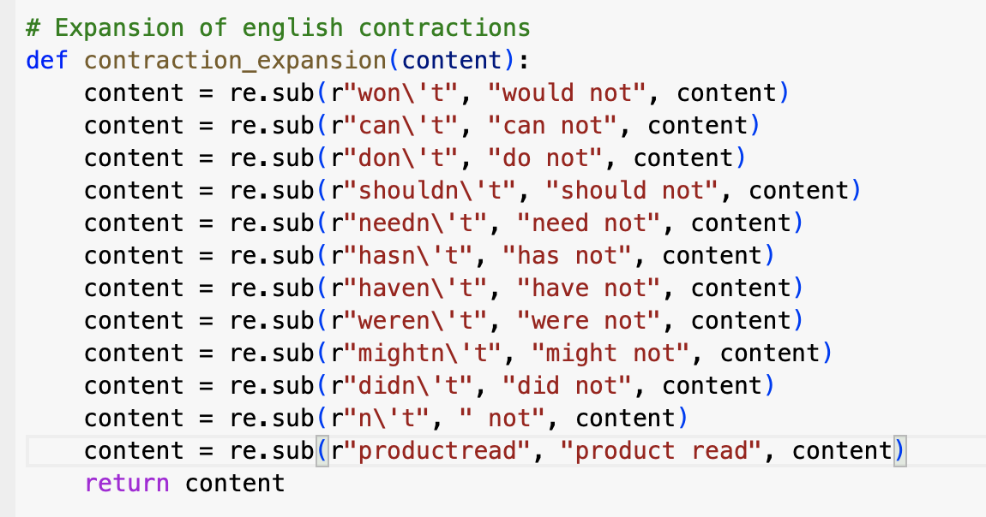
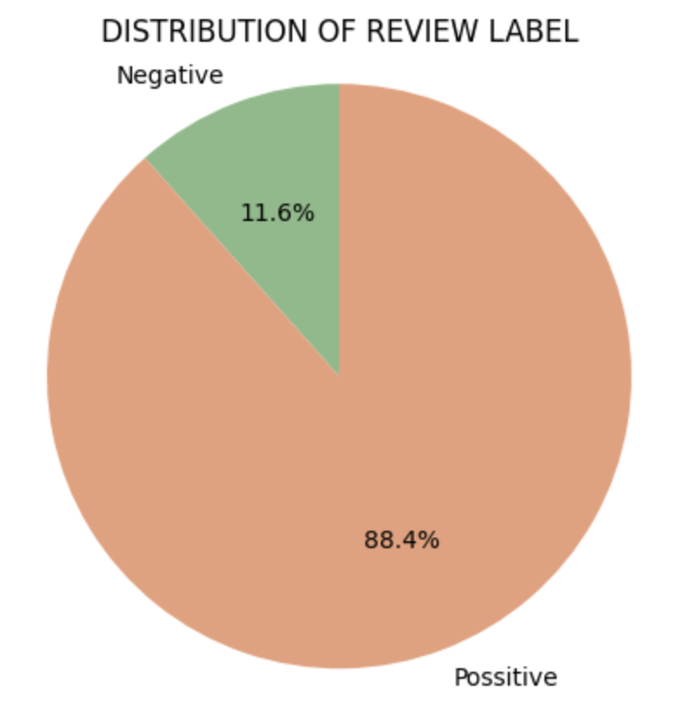
Sentiment Analysis using Python
(updated)
MACHINE LEARNING MODEL
TF-IDF SCORE
WORDCLOUD
DATA PROCESSING
SUMMARY
PREVIOUS
IMPROVEMENT
MODIFY THE STOPWORDS
THAO TRAN (★★★★★)
_______________________________________________________
_______________________________________________________
______________________________________________________
THU TRAN (★★★)
_______________________________________________________
_______________________________________________________
______________________________________________________
1
HUITING WU (★★★★)
_______________________________________________________
_______________________________________________________
______________________________________________________
CHECK DUPLICATE
CHECK DUPLICATE
Forget to check the duplicates
REVIEW LABEL
REVIEW LABEL
Label 1 (‘Positive’) for rating 5 stars, and label 0 (’Negative’) for otherwise
Label 1 (‘Positive’) for rating 3 stars and above,
and label 0 (’Negative’) for otherwise

Slide 5
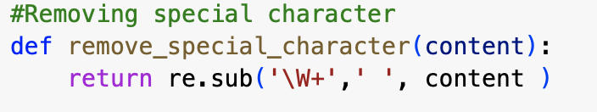
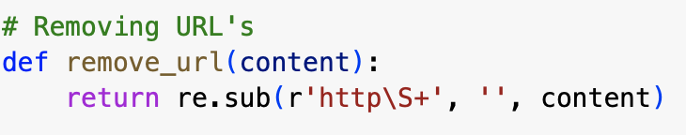
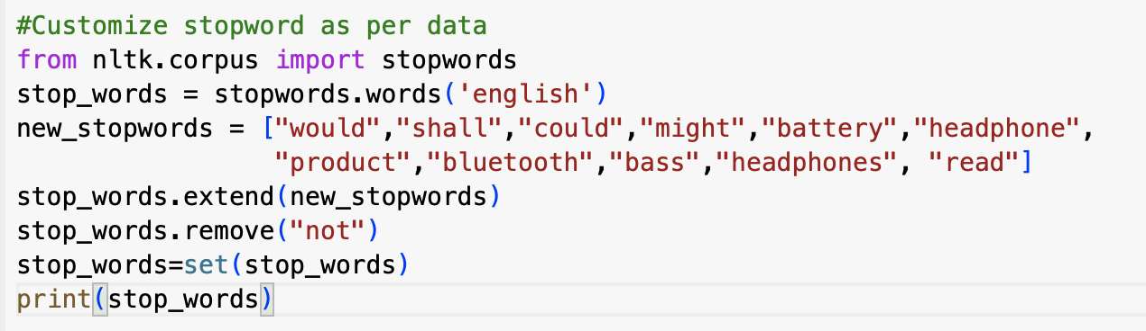
Sentiment Analysis using Python
(updated)
MACHINE LEARNING MODEL
TF-IDF SCORE
WORDCLOUD
DATA PROCESSING
SUMMARY
PREVIOUS
IMPROVEMENT
DATA CLEANING AND MODIFY THE STOPWORDS
THAO TRAN (★★★★★)
_______________________________________________________
_______________________________________________________
______________________________________________________
2
THU TRAN (★★★)
_______________________________________________________
_______________________________________________________
______________________________________________________
3
HUITING WU (★★★★)
_______________________________________________________
_______________________________________________________
______________________________________________________
4
CHECK DUPLICATE
CHECK DUPLICATE
Forget to check the duplicates
REVIEW LABEL
REVIEW LABEL
Label 1 (‘Positive’) for rating 5 stars, and label 0 (’Negative’) for otherwise
Label 1 (‘Positive’) for rating 3 stars and above,
and label 0 (’Negative’) for otherwise

Slide 6
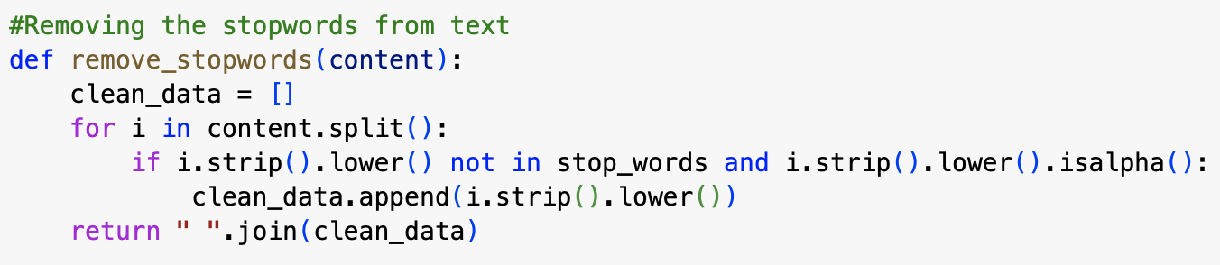
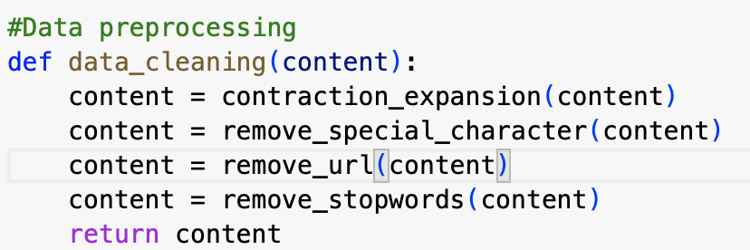
Sentiment Analysis using Python
(updated)
MACHINE LEARNING MODEL
TF-IDF SCORE
WORDCLOUD
DATA PROCESSING
SUMMARY
PREVIOUS
IMPROVEMENT
DATA CLEANING AND MODIFY THE STOPWORDS
THAO TRAN (★★★★★)
_______________________________________________________
_______________________________________________________
______________________________________________________
5
THU TRAN (★★★)
_______________________________________________________
_______________________________________________________
______________________________________________________
HUITING WU (★★★★)
_______________________________________________________
_______________________________________________________
______________________________________________________
1
2
3
5
CHECK DUPLICATE
CHECK DUPLICATE
Forget to check the duplicates
REVIEW LABEL
REVIEW LABEL
Label 1 (‘Positive’) for rating 5 stars, and label 0 (’Negative’) for otherwise
Label 1 (‘Positive’) for rating 3 stars and above,
and label 0 (’Negative’) for otherwise

Slide 7
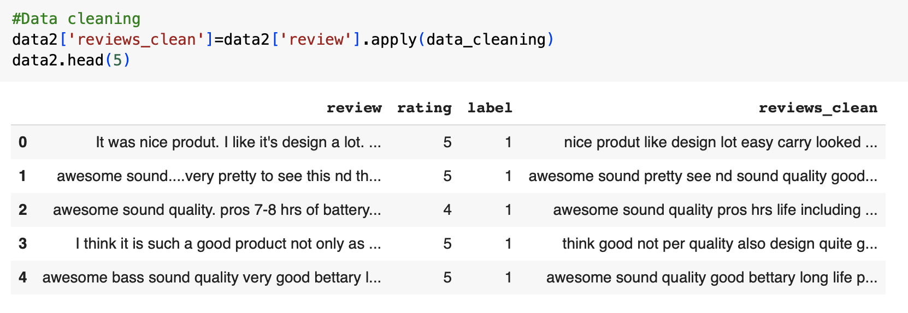
Sentiment Analysis using Python
(updated)
MACHINE LEARNING MODEL
TF-IDF SCORE
WORDCLOUD
DATA PROCESSING
SUMMARY
PREVIOUS
IMPROVEMENT
DATA CLEANING AND MODIFY THE STOPWORDS
THAO TRAN (★★★★★)
_______________________________________________________
_______________________________________________________
______________________________________________________
THU TRAN (★★★)
_______________________________________________________
_______________________________________________________
______________________________________________________
HUITING WU (★★★★)
_______________________________________________________
_______________________________________________________
______________________________________________________
CHECK DUPLICATE
CHECK DUPLICATE
Forget to check the duplicates
REVIEW LABEL
REVIEW LABEL
Label 1 (‘Positive’) for rating 5 stars, and label 0 (’Negative’) for otherwise
Label 1 (‘Positive’) for rating 3 stars and above,
and label 0 (’Negative’) for otherwise

Slide 8
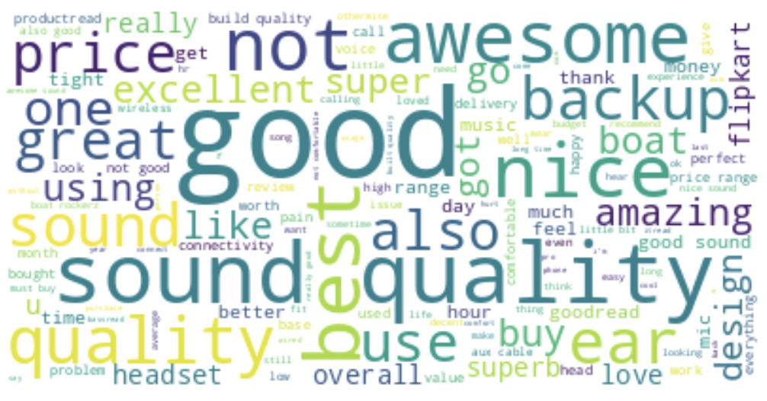
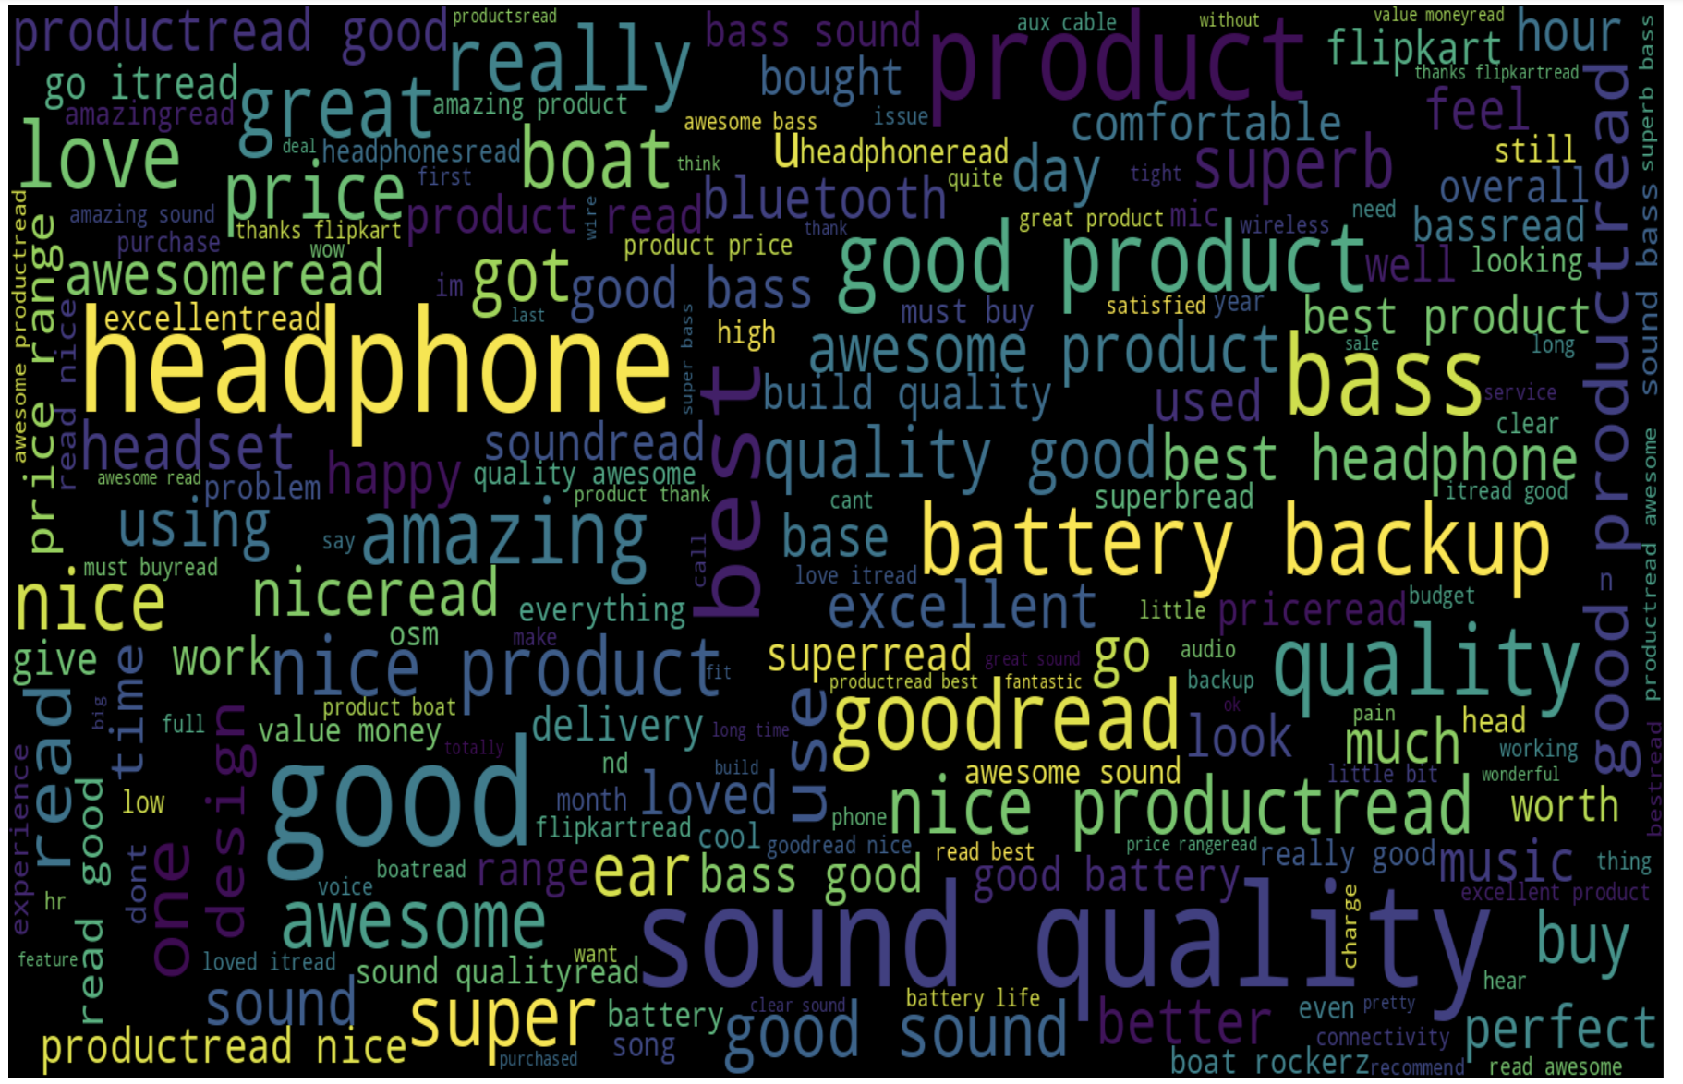
Sentiment Analysis using Python
(updated)
MACHINE LEARNING MODEL
DATA PROCESSING
TF-IDF SCORE
WORDCLOUD
SUMMARY
PREVIOUS
IMPROVEMENT
POSITIVE REVIEW
POSITIVE REVIEW
THAO TRAN (★★★★★)
_______________________________________________________
_______________________________________________________
______________________________________________________
THU TRAN (★★★)
_______________________________________________________
_______________________________________________________
______________________________________________________
HUITING WU (★★★★)
_______________________________________________________
_______________________________________________________
______________________________________________________

Slide 9
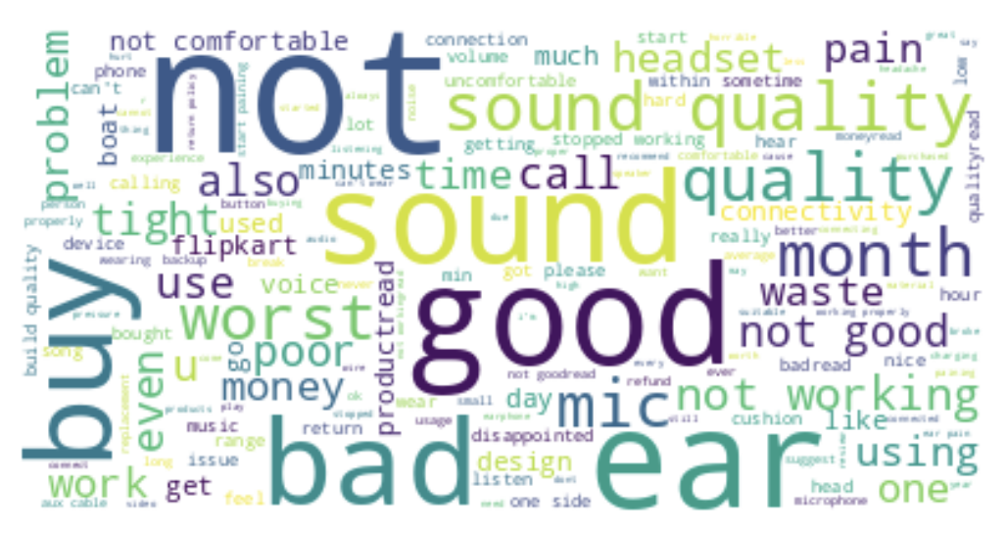
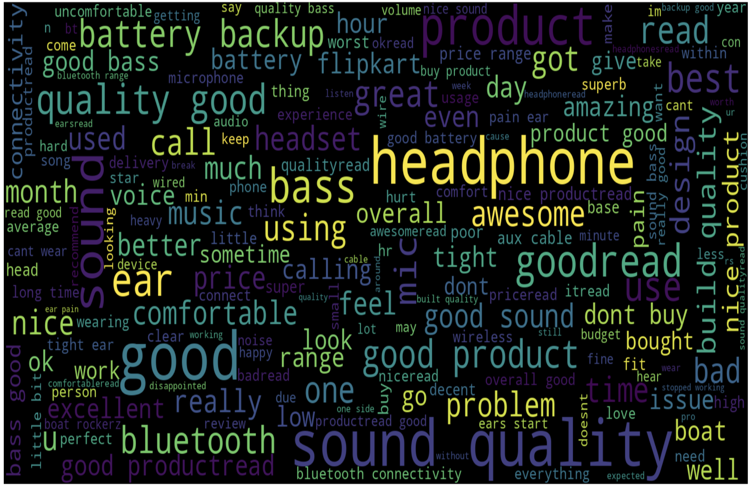
Sentiment Analysis using Python
(updated)
MACHINE LEARNING MODEL
DATA PROCESSING
TF-IDF SCORE
WORDCLOUD
SUMMARY
PREVIOUS
IMPROVEMENT
NEGATIVE REVIEW
NEGATIVE REVIEW
THAO TRAN (★★★★★)
_______________________________________________________
_______________________________________________________
______________________________________________________
THU TRAN (★★★)
_______________________________________________________
_______________________________________________________
______________________________________________________
HUITING WU (★★★★)
_______________________________________________________
_______________________________________________________
______________________________________________________

Slide 10
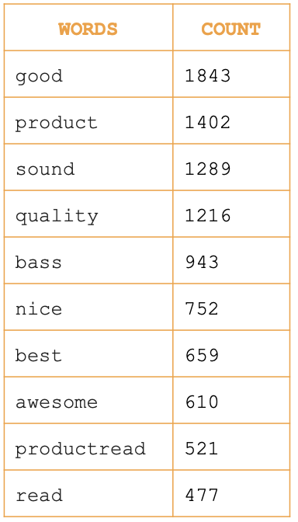
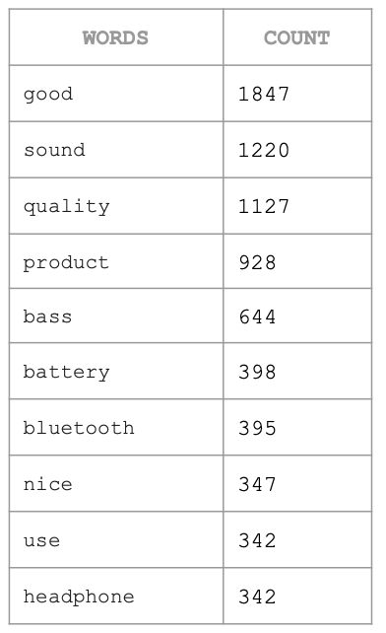
Sentiment Analysis using Python
(updated)
MACHINE LEARNING MODEL
DATA PROCESSING
TF-IDF SCORE
WORDCLOUD
SUMMARY
PREVIOUS
IMPROVEMENT
POSSITIVE REVIEW
NEGATIVE REVIEW
POSSITIVE REVIEW
NEGATIVE REVIEW
WORDS | COUNT
good | 3967
sound | 2487
quality | 2309
not | 1810
nice | 1152
best | 1080
awesome | 992
price | 843
also | 636
backup | 569
WORDS | COUNT
not | 681
good | 213
sound | 206
quality | 200
buy | 130
working | 125
bad | 122
ears | 102
worst | 81
mic | 78
THAO TRAN (★★★★★)
_______________________________________________________
_______________________________________________________
______________________________________________________
THU TRAN (★★★)
_______________________________________________________
_______________________________________________________
______________________________________________________
HUITING WU (★★★★)
_______________________________________________________
_______________________________________________________
______________________________________________________

Slide 11
Sentiment Analysis using Python
(updated)
WORDCLOUD
MACHINE LEARNING MODEL
DATA PROCESSING
TF-IDF SCORE
SUMMARY
Term Frequency - Inverse Document Frequency (TF-IDF) is a widely used statistical method in natural language processing and information retrieval.
Term Frequency: TF of a term or word is the number of times the term appears in a document compared to the total number of words in the document.
Inverse Document Frequency: IDF of a term reflects the proportion of documents in the X corpus that contain the term. Words unique to a small percentage of documents (e.g., technical jargon terms) receive higher importance values than words common across all documents (e.g., a, the, and).
THAO TRAN (★★★★★)
_______________________________________________________
_______________________________________________________
______________________________________________________
THU TRAN (★★★)
_______________________________________________________
_______________________________________________________
______________________________________________________
HUITING WU (★★★★)
_______________________________________________________
_______________________________________________________
______________________________________________________

Slide 12
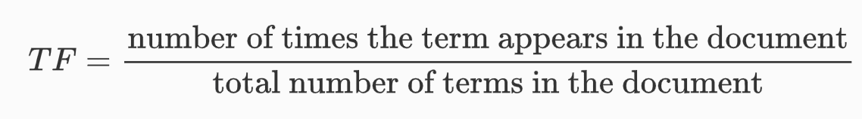
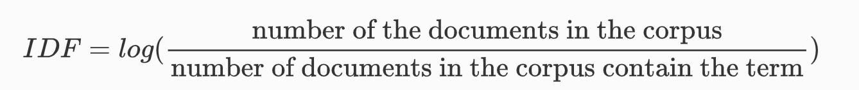
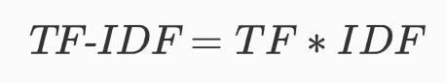
Sentiment Analysis using Python
(updated)
WORDCLOUD
MACHINE LEARNING MODEL
DATA PROCESSING
TF-IDF SCORE
SUMMARY
THAO TRAN (★★★★★)
_______________________________________________________
_______________________________________________________
______________________________________________________
THU TRAN (★★★)
_______________________________________________________
_______________________________________________________
______________________________________________________
HUITING WU (★★★★)
_______________________________________________________
_______________________________________________________
______________________________________________________

Slide 13
Sentiment Analysis using Python
(updated)
WORDCLOUD
MACHINE LEARNING MODEL
DATA PROCESSING
TF-IDF SCORE
SUMMARY
There are 10000 reviews in the dataset. Only 100 reviews contains the term “Love”. And the term “Love” appears 20 times in one of the reviews which contains 100 words in total.
TF = 20/100 = 0.2
IDF = log(10000/100) = 2
TF-IDF score of “Love” in that document is TF*IDF = 0.2*2 = 0.4
THAO TRAN (★★★★★)
_______________________________________________________
_______________________________________________________
______________________________________________________
THU TRAN (★★★)
_______________________________________________________
_______________________________________________________
______________________________________________________
HUITING WU (★★★★)
_______________________________________________________
_______________________________________________________
______________________________________________________

Slide 14
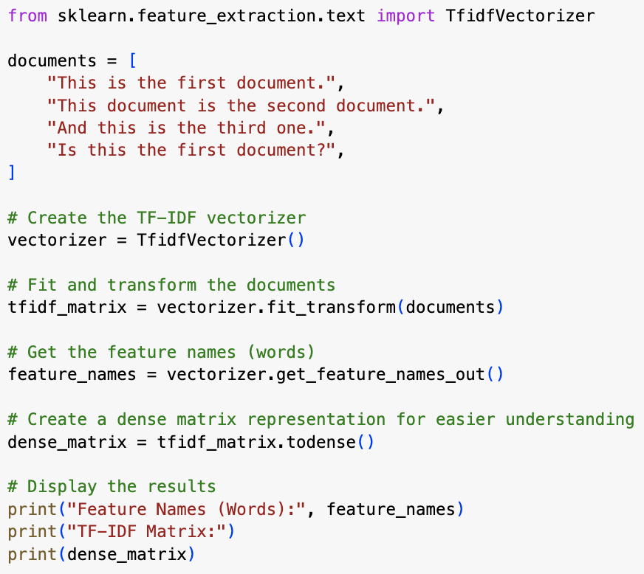
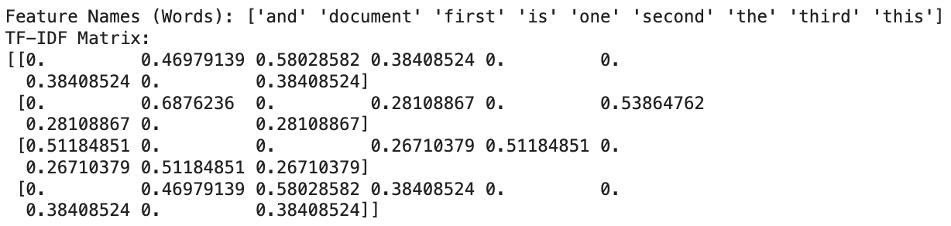
Sentiment Analysis using Python
(updated)
WORDCLOUD
MACHINE LEARNING MODEL
DATA PROCESSING
TF-IDF SCORE
SUMMARY
EXAMPLE
THAO TRAN (★★★★★)
_______________________________________________________
_______________________________________________________
______________________________________________________
THU TRAN (★★★)
_______________________________________________________
_______________________________________________________
______________________________________________________
HUITING WU (★★★★)
_______________________________________________________
_______________________________________________________
______________________________________________________
RESOURCES
TF-IDF — Term Frequency-Inverse Document Frequency by Fatih Karabiber
https://www.learndatasci.com/glossary/tf-idf-term-frequency-inverse-document-frequency/#:~:text=Using%20scikit%2Dlearn-,What%20is%20TF%2DIDF%3F,%2C%20relative%20to%20a%20corpus

Slide 15
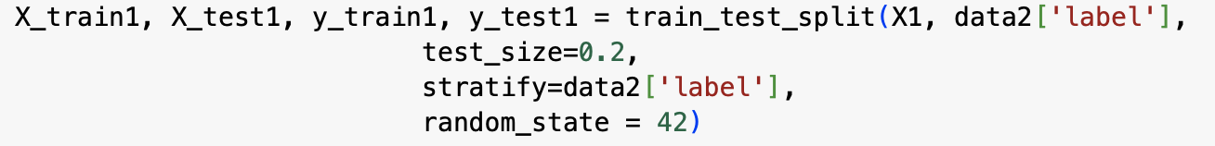
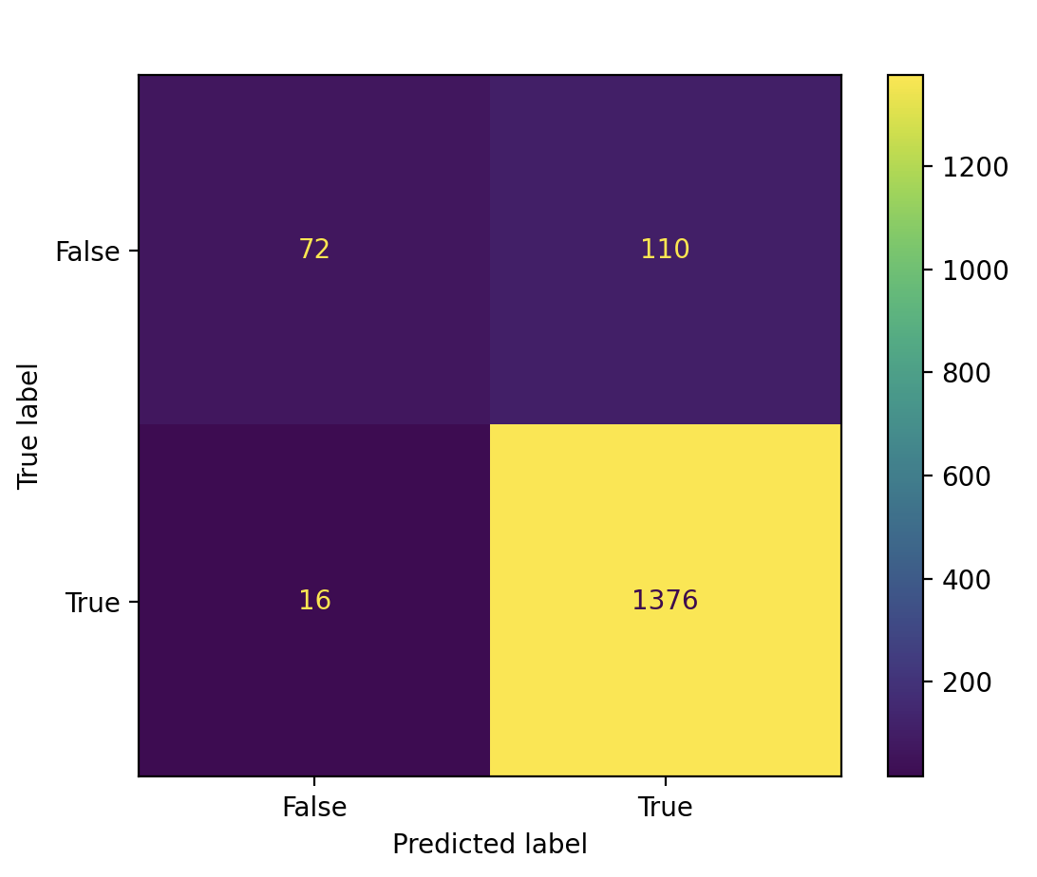
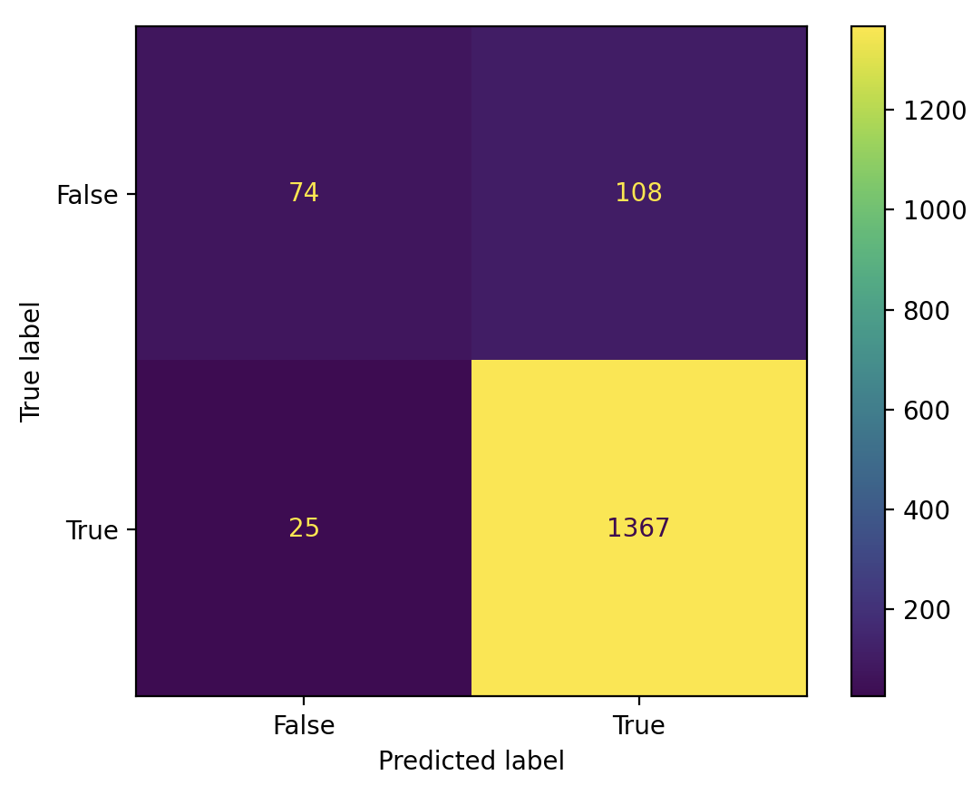

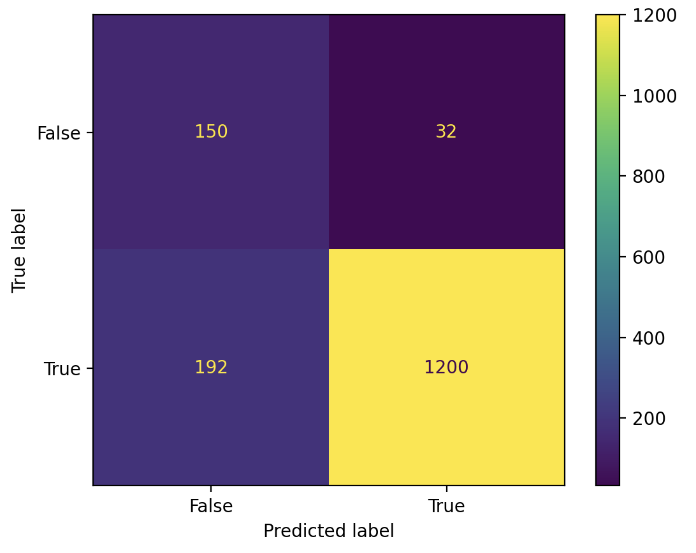
Sentiment Analysis using Python
(updated)
WORDCLOUD
TF-IDF SCORE
MACHINE LEARNING MODEL
DATA PROCESSING
SUMMARY
DATA SPLITING
THAO TRAN (★★★★★)
_______________________________________________________
_______________________________________________________
______________________________________________________
CONFUSION MATRIX
THU TRAN (★★★)
_______________________________________________________
_______________________________________________________
______________________________________________________
HUITING WU (★★★★)
_______________________________________________________
_______________________________________________________
______________________________________________________
LOGISTIC REGRESSION
RANDOM FOREST
SUPPORT VECTOR MACHINES
XGBOOST

Slide 16
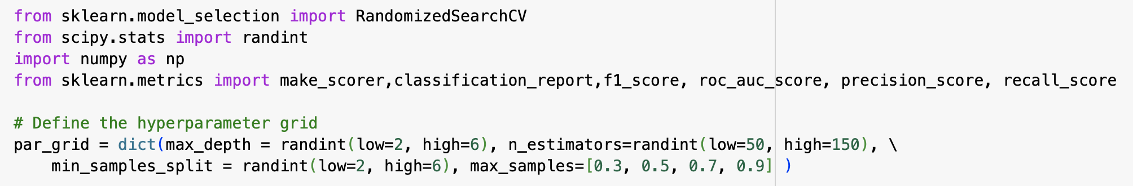
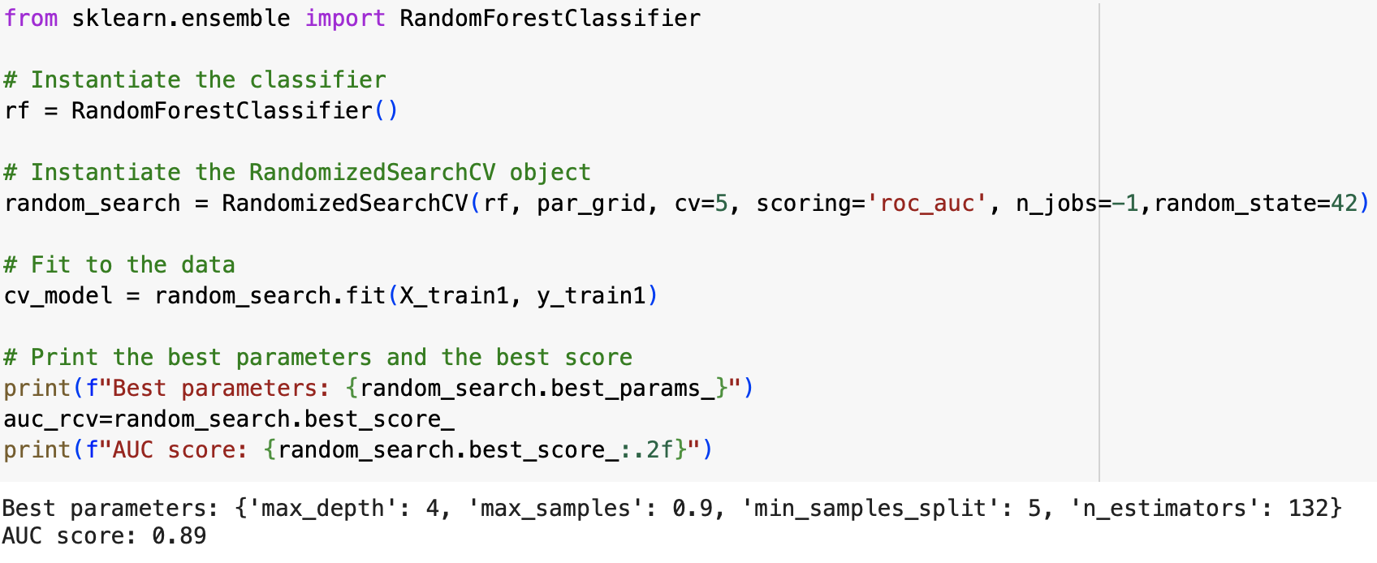
Sentiment Analysis using Python
(updated)
WORDCLOUD
MACHINE LEARNING MODEL
DATA PROCESSING
SUMMARY
CROSS VALIDATION
TF-IDF SCORE
THAO TRAN (★★★★★)
_______________________________________________________
_______________________________________________________
______________________________________________________
HYPER PARAMETER TUNNING
THU TRAN (★★★)
_______________________________________________________
_______________________________________________________
______________________________________________________
RANDOMIZEDSEARCHCV
(using R.Forest estimator)
HUITING WU (★★★★)
_______________________________________________________
_______________________________________________________
______________________________________________________
OUTPUT
CONFUSION MATRIX
LOGISTIC REGRESSION
RANDOM FOREST
SUPPORT VECTOR MACHINES
XGBOOST

Slide 17
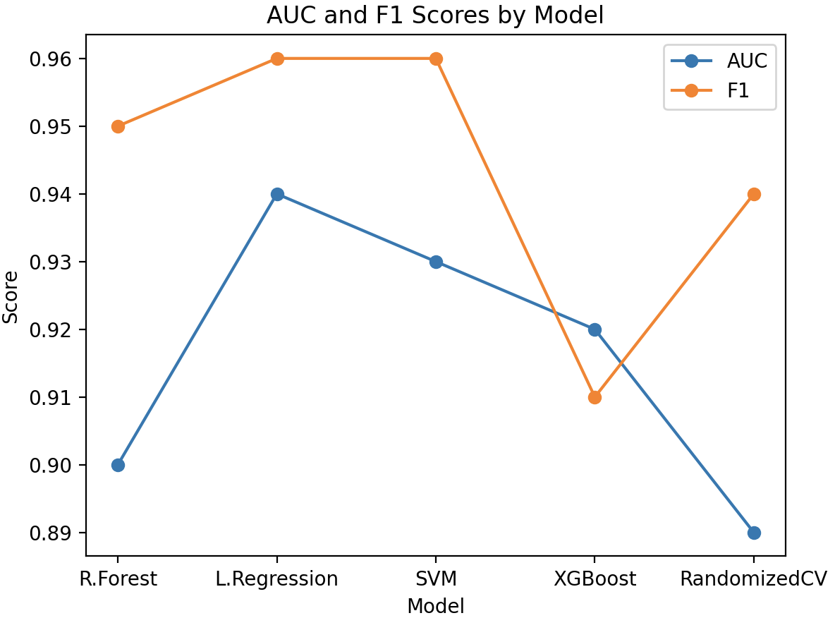
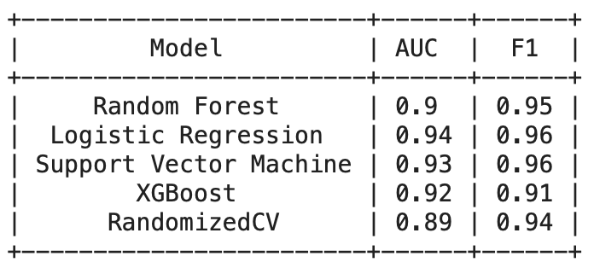
Sentiment Analysis using Python
(updated)
WORDCLOUD
MACHINE LEARNING MODEL
DATA PROCESSING
SUMMARY
METRIC TABLE
TF-IDF SCORE
THAO TRAN (★★★★★)
_______________________________________________________
_______________________________________________________
______________________________________________________
THU TRAN (★★★)
_______________________________________________________
_______________________________________________________
______________________________________________________
HUITING WU (★★★★)
_______________________________________________________
_______________________________________________________
______________________________________________________
CONFUSION MATRIX
LOGISTIC REGRESSION
RANDOM FOREST
SUPPORT VECTOR MACHINES
XGBOOST

Slide 18
Sentiment Analysis using Python
(updated)
WORDCLOUD
SUMMARY
DATA PROCESSING
Some steps that we use to update our model
Remove the duplicate rows
Change ‘label’ of positive and negative review
Modify the remove “stopwords”
Better wordcloud visualization.
Change the splitting data to 80:20
Use different method of machine learning model: Logistic Regression, Random Forest, SVM, XGBoost, RandomizedSearchCV.
Use different metrics to evaluate the model: AUC, F1-score
CONCLUSION:
After doing all steps above, the best machine learning model to predict “positive” and “negative” reviews is logistic regression with the AUC = 0.94, and F1-score = 0.96 which is much improvement from the last time AUC = 0.6773
MACHINE LEARNING MODEL
TF-IDF SCORE
THAO TRAN (★★★★★)
_______________________________________________________
_______________________________________________________
______________________________________________________
THU TRAN (★★★)
_______________________________________________________
_______________________________________________________
______________________________________________________
HUITING WU (★★★★)
_______________________________________________________
_______________________________________________________
______________________________________________________

